Slide 1

Matthew Chun
Carl Ross
Tracy Tran
Carson Wilk
Matthew Chun
Carl Ross
Tracy Tran
Carson Wilk

Slide 2
Overall Problem

Slide 3
Motivation
People want to…
- Be more environmentally friendly¹
85% expressing a desire to own an eco-friendly home
- Save money²
21% of income on housing-related costs
http://www.realtor.com/news/real-estate-news/most-americans-want-eco-friendly-homes¹
http://www.fool.com/retirement/general/2016/02/15/heres-how-much-the-average-american-family-spend-2.aspx²
Notes:
The easiest step towards achieving both goals is through decreasing utility consumption.

Slide 4
Problem
Barriers are…
- Delayed feedback
Absence of personal accountability
- Lack of conscious thought about usage
- Prioritized convenience

Slide 5
Solution Overview

Slide 6
Solution Overview
Centralized, informational hub
Increases frequency and availability of feedback
Leverages social motivation
- Increases awareness and accountability

Slide 7
Initial Paper Prototype

Slide 8
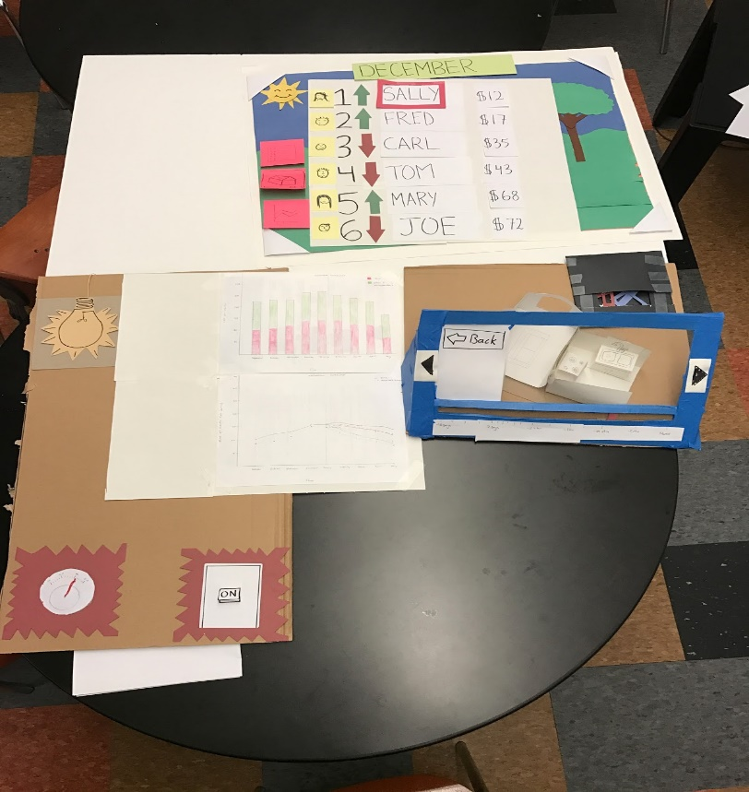
Overview

Slide 9
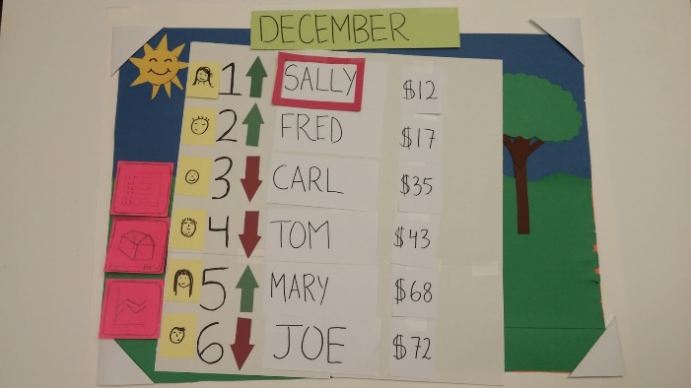
Task 1: Understand and compare your usage

Slide 10
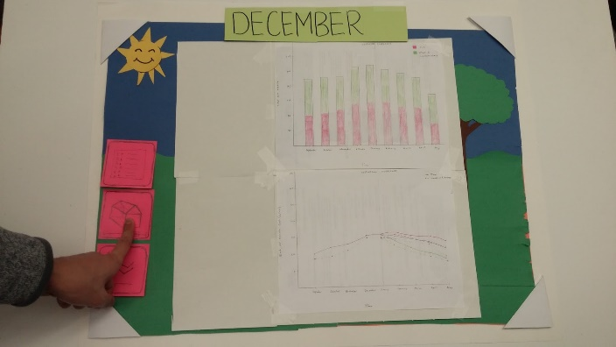
Task 1: Understand and compare your usage

Slide 11
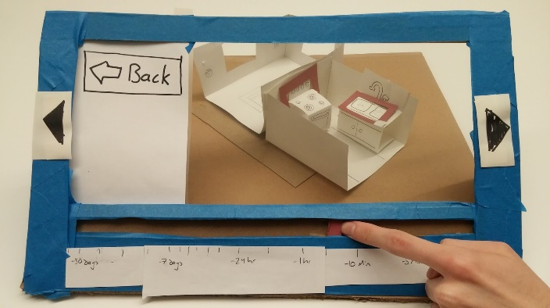
Task 1: Understand and compare your usage

Slide 12
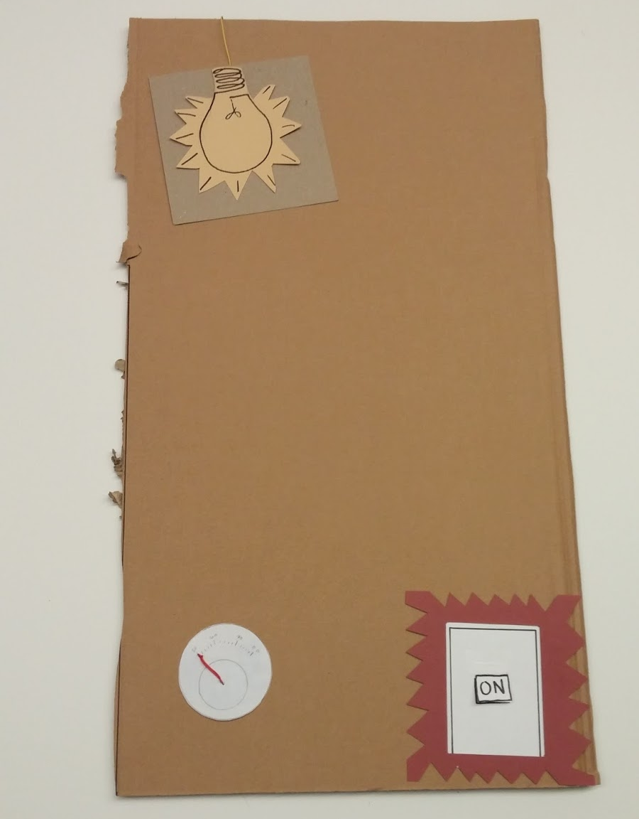
Task 2: Control appliances remotely and pay what you use

Slide 13
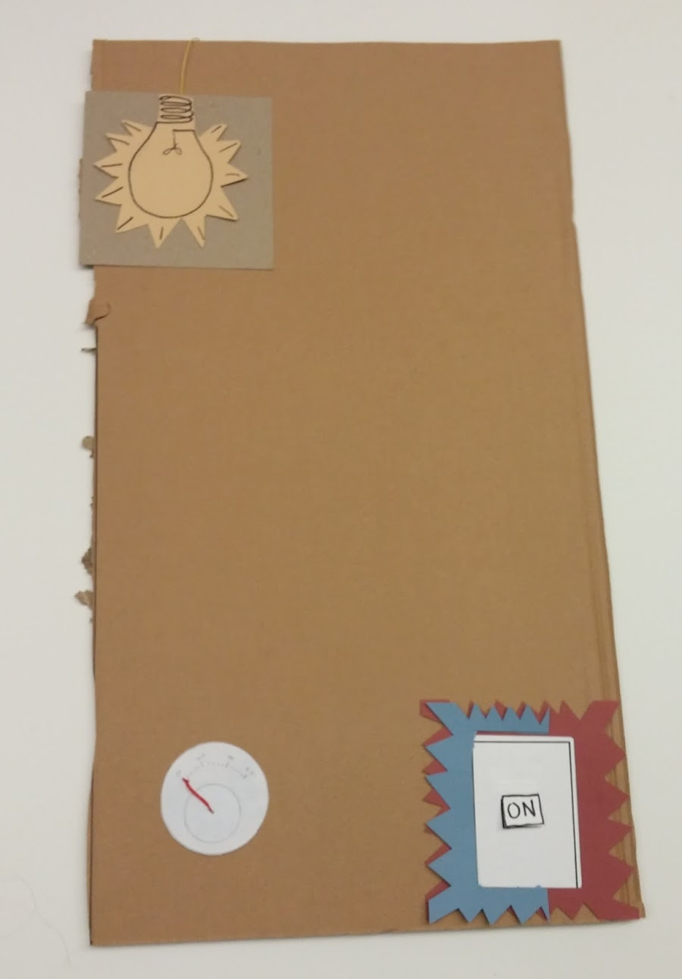
Task 2: Control appliances remotely and pay what you use

Slide 14
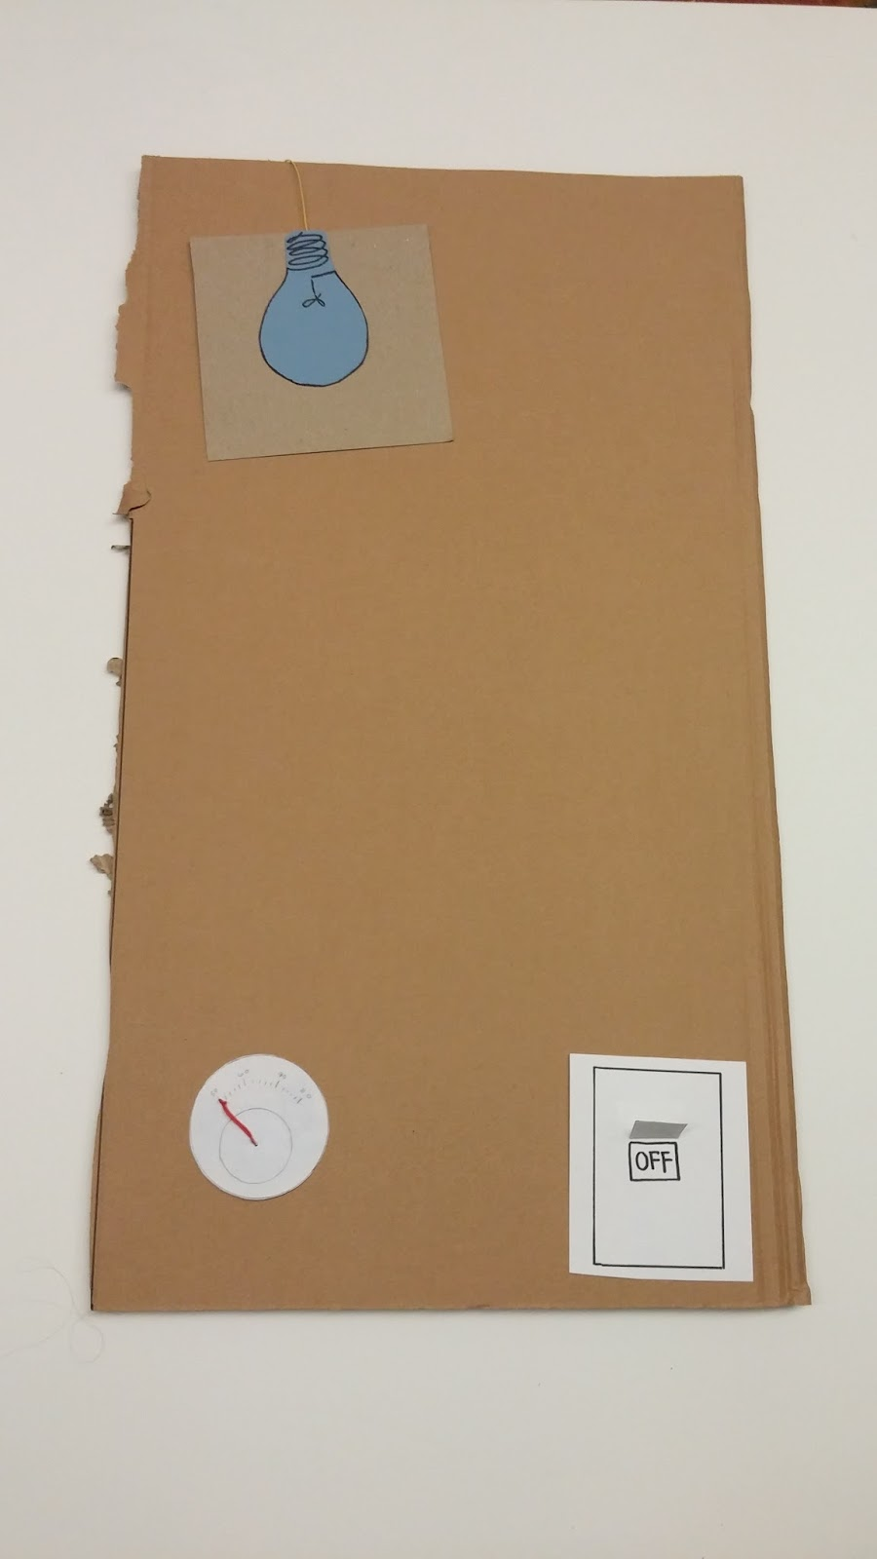
Task 2: Control appliances remotely and pay what you use

Slide 15
Testing Process and Results

Slide 16
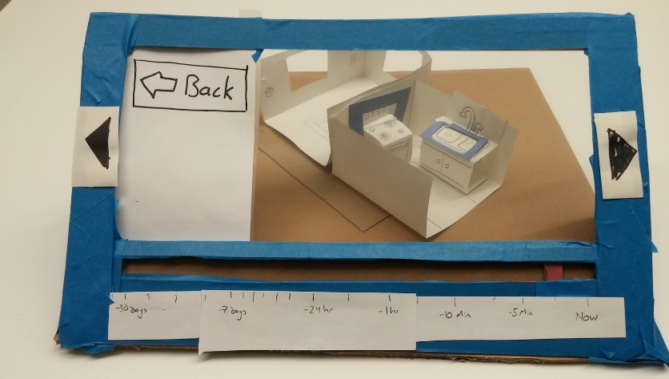
Heuristic Violations
Recognition rather than recall
Help and documentation
Consistency and standards
- Flexibility and efficiency of use
User control and freedom
Aesthetic and minimalist design

Slide 17
Usability Testing Process
- Demographic: young adults living in shared housing
3 objectives
Figure out why your bill is so high
Disable tracking for the oven
Disable tracking for Sally

Slide 18
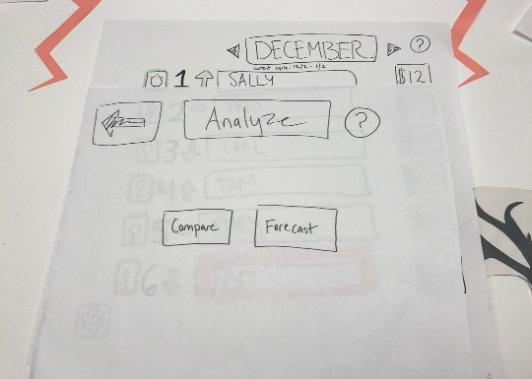
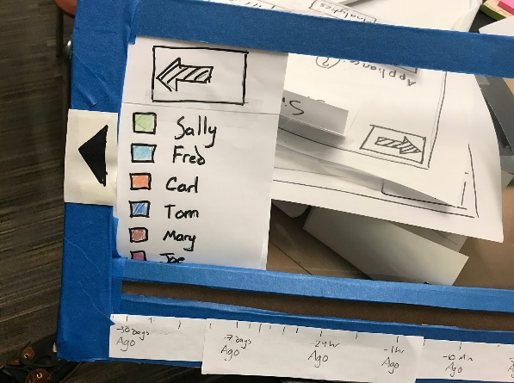
Usability Testing Results
- Multiple ways to navigate
- Awareness of system status
Consistency across screens

Slide 19
Final Paper Prototype

Slide 20
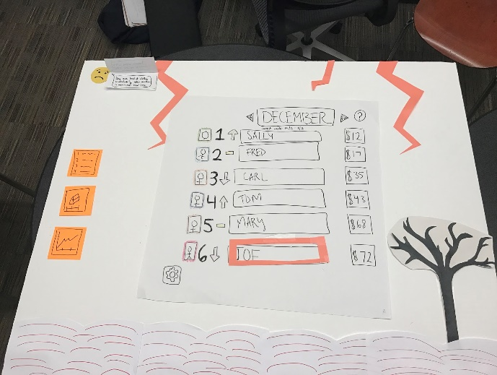
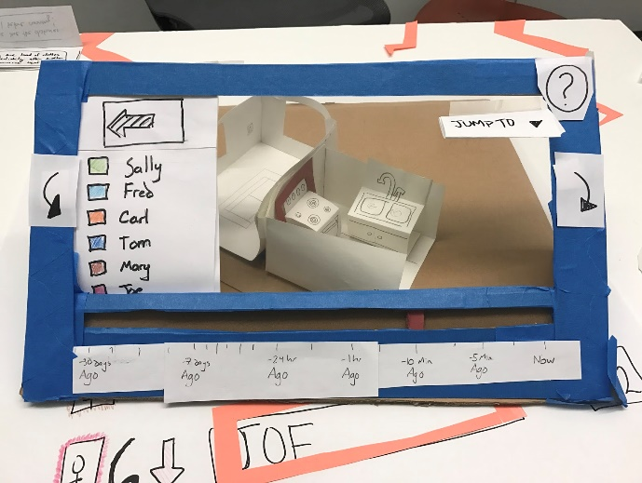
Task 1: Understand why your bill is so high

Slide 21
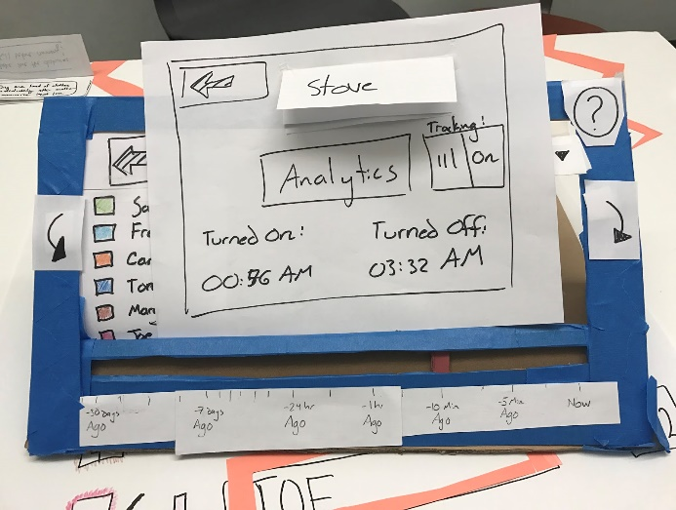

Task 1: Understand why your bill is so high

Slide 22
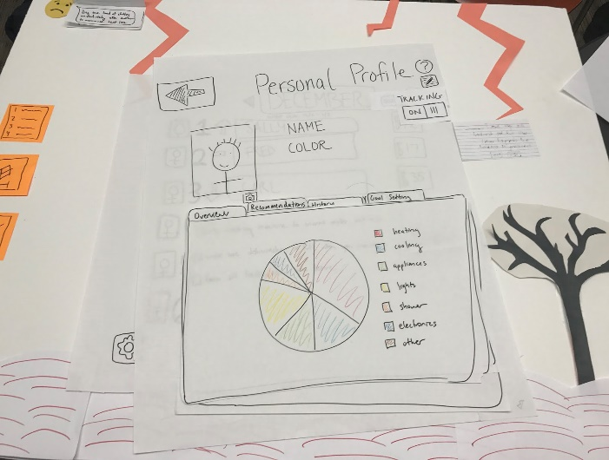
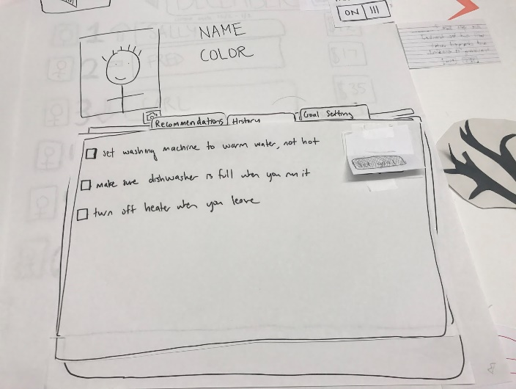
Task 1: Understand why your bill is so high

Slide 23
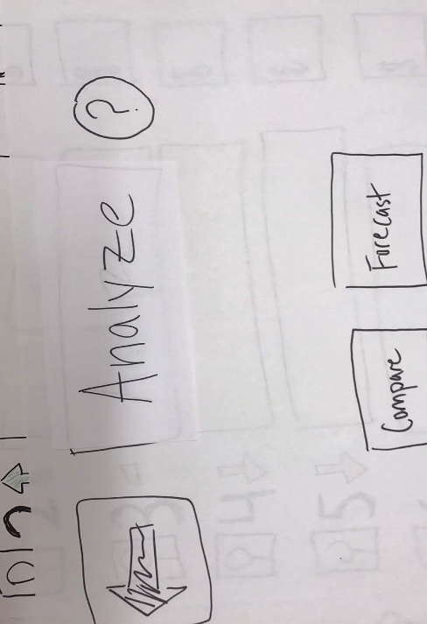

Task 2: Compare your usage

Slide 24
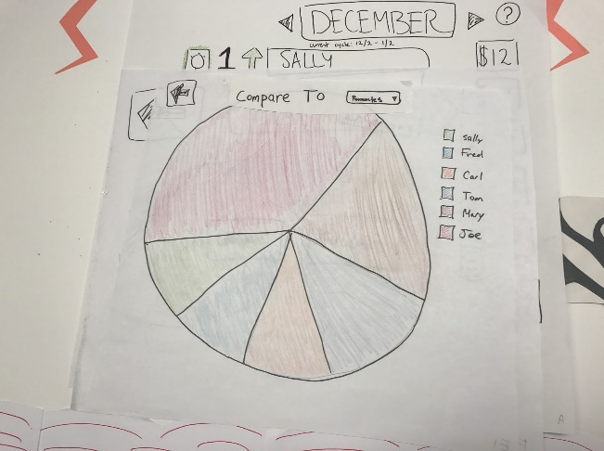
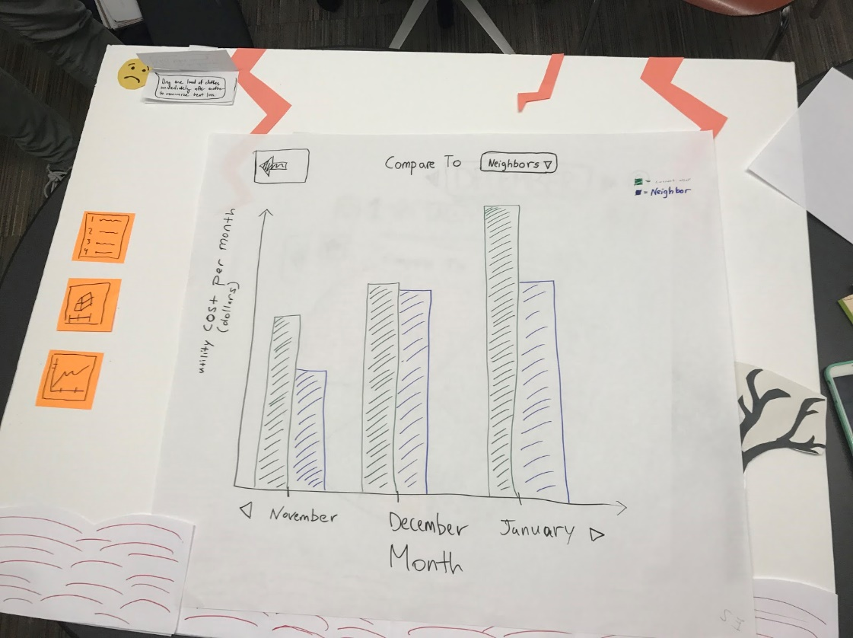
Task 2: Compare your usage

Slide 25
Digital Mockup

Slide 26
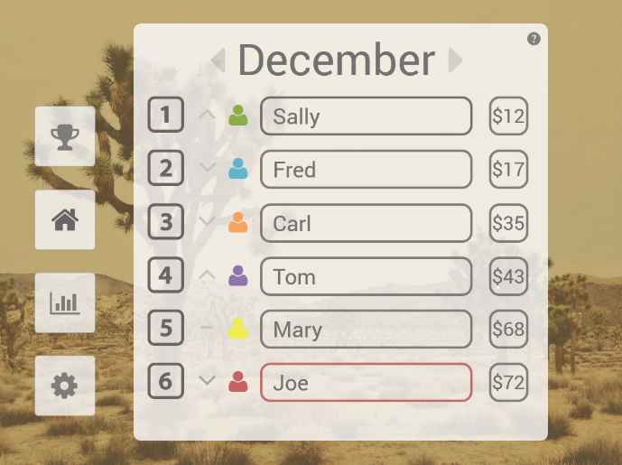
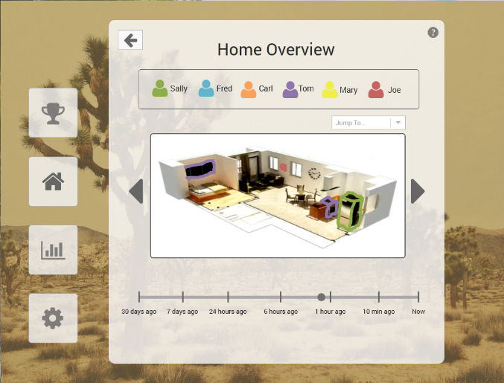
Task 1: Understand why your bill is so high

Slide 27
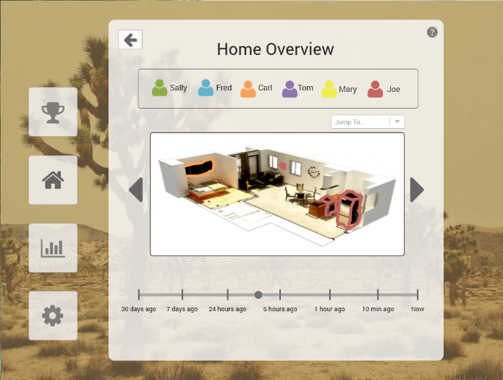
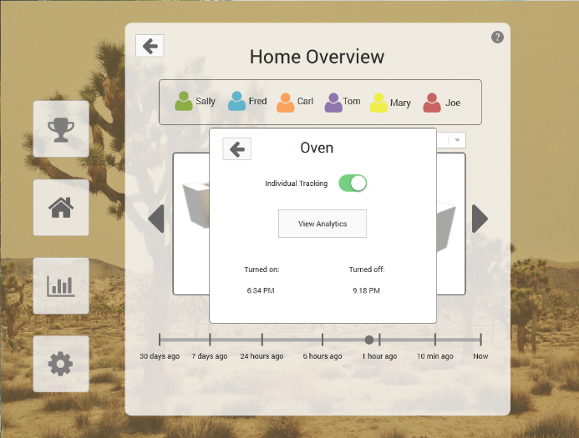
Task 1: Understand why your bill is so high

Slide 28
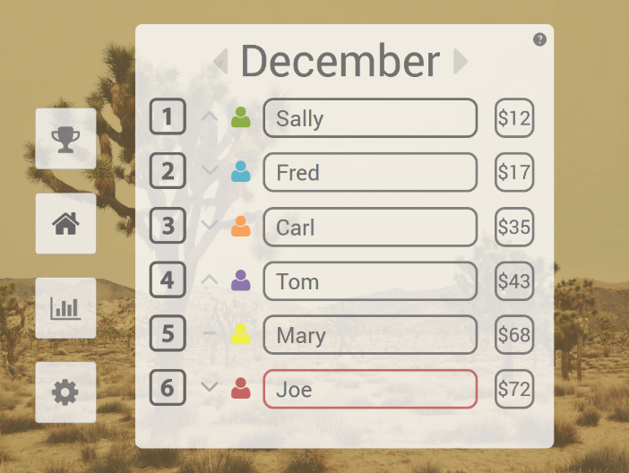
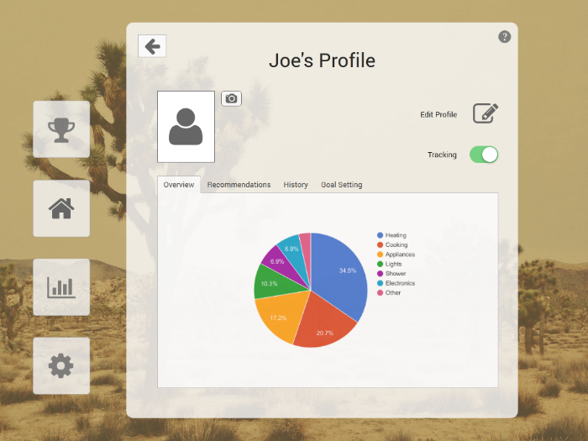
Task 1: Understand why your bill is so high

Slide 29
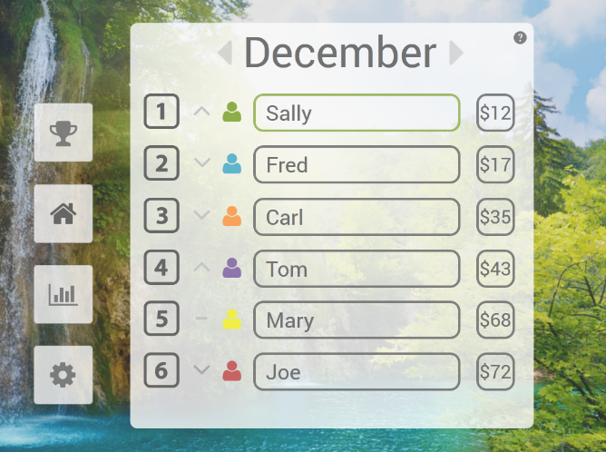
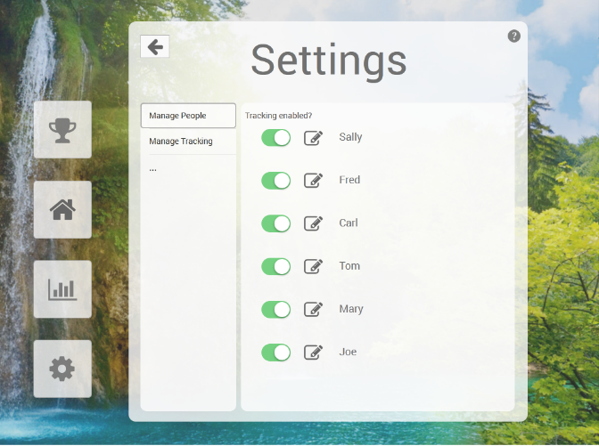
Task 2: Disable tracking for the oven

Slide 30
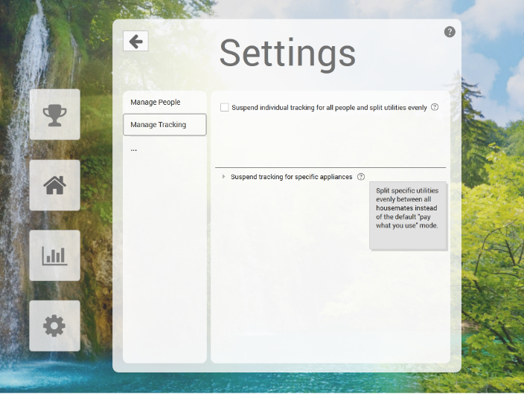
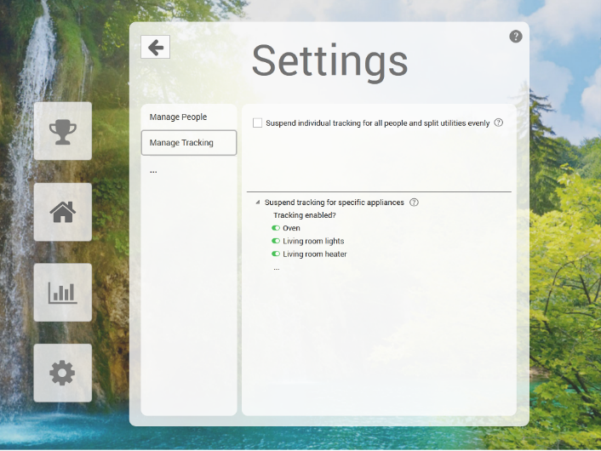
Task 2: Disable tracking for the oven

Slide 31
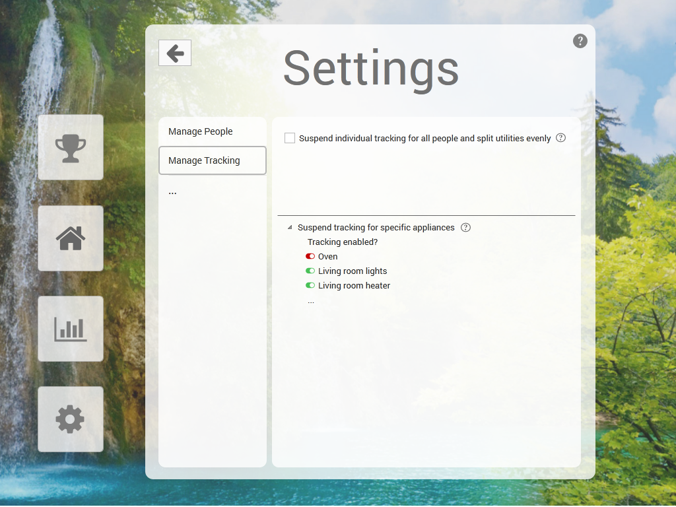
Task 2: Disable tracking for the oven

Slide 32
Summary

Slide 33
Summary
- Refine and specify concrete tasks
Multiple ways to navigate
- Consistency is key

